Slide 1


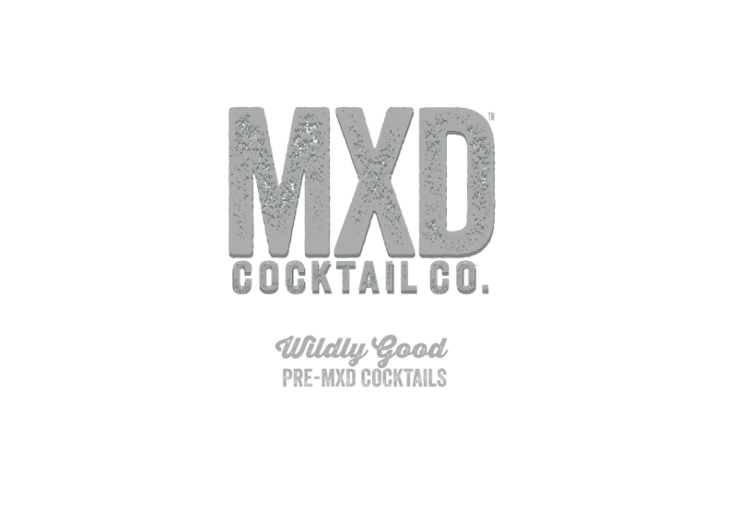
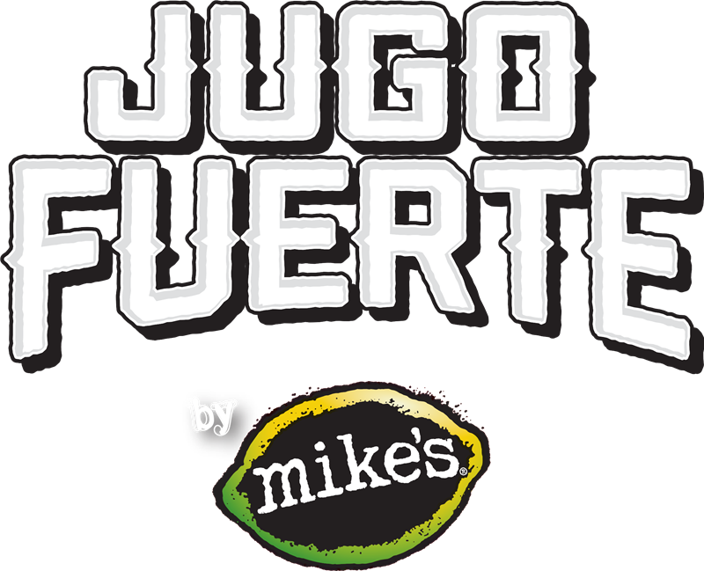
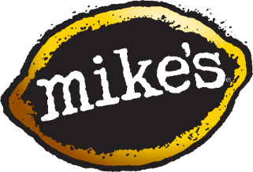
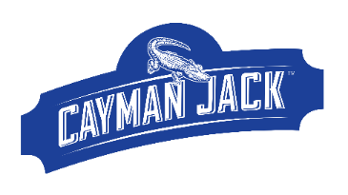
F21 BRAND PLANNING Phase 1: 2018 Deep Dive
January 2019

Slide 2
Planning Notes
Time Periods
IRI 52 Weeks Ending 11-04-18
IRI 123 Days of Summer (custom aggregate)
Phase 1 Milestone Dates
Week of Dec 31 – check in with Sanjiv and MABIC
Week of Jan 14 – review with Sanjiv, Steve, Ian and Tracey
Week of Jan 21 – presentation to ELT
Week of Feb 4 – QBR pre-read sent out
Week of Feb 11 – QBR

Slide 3
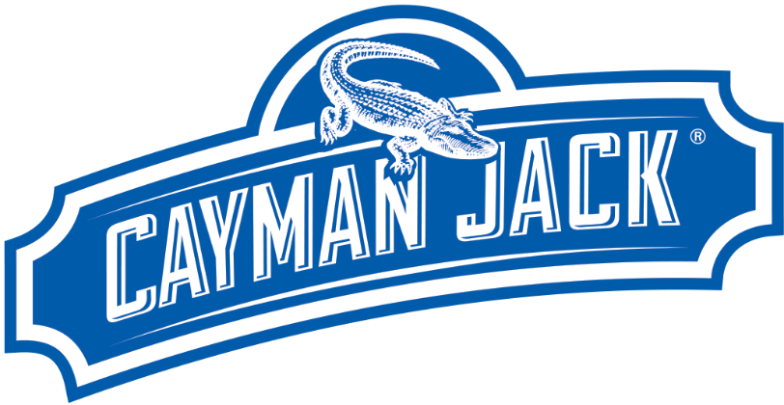

Slide 4
Brand Performance
Include brand, pack size, and sku level performance
Consider YTD as well as monthly/weekly trended data

Slide 5

Cayman & the Category – 52 Week
Overall beer category dollars year to date have grown 2%, driven by FMBs (+10%), Ciders (+9%), and Seltzers (+185%)
Prices are flat across the industry, except Hard Seltzer (+3.6%) and Cider (+4%)
Hard Seltzer continues to drive growth in both price and dollars
 | Dollars | % Change Year Ago | Price per Unit | % Change Year Ago
Beer | $35,358,014,318 | +1.9% | $6.92 | +0.6%
Craft | $4,183,199,185 | +3.1% | $9.72 | +0.7%
FMB | $2,756,900,873 | +9.7% | $4.05 | +0.0%
Cider | $428,329,123 | +9.0% | $8.02 | +4.0%
Hard Seltzer | $373,269,786 | +184.8% | $10.96 | +3.6%
Cayman Jack | $26,423,221 | +26.1% | $8.81 | +11.6%
IRI, Total MULO + Conv, Latest 52 weeks ending 11/04/18

Slide 6
Cayman & the Category – Summer
During the summer beer dollar growth was primarily driven by hard seltzers and FMBs
Some of this dollar growth is explained by price increases in cider (+5.7%), seltzer (+3.7%), and FMB (+2.8%)
Despite price increases in the fastest growing subsegments of beer, overall beer price per unit is up less than one percent.
 | Dollars | % Change Year Ago | Price per Unit | % Change Year Ago
Beer | $14,474,011,868 | +2.8% | $7.04 | +0.7%
Craft | $1,677,047,500 | +2.0% | $9.75 | -0.6%
FMB | $1,267,374,787 | +12.0% | $4.34 | +2.8%
Cider | $179,361,402 | +14.2% | $8.23 | +5.7%
Hard Seltzer | $220,733,423 | +177.4% | $11.07 | +3.7%
Cayman Jack | $13,265,473 | +27.5% | $9.24 | +15.5%
IRI, Total MULO + Conv, 123 Days of Summer

Slide 7
Cayman Jack by Channel – 52 Week
 | Dollars | Dollar Growth | Price per Unit | Price Growth | CWD | CWD Growth
MUL-C | $26,423,221 | +26.1% | $8.81 | +11.6% | 31.22 | +26%
Food | $14,012,410 | +23.9% | $9.22 | +11.2% | 50.69 | +13%
Conv. | $6,476,378 | +33.5% | $7.83 | +25.5% | 18.43 | +32%
Cayman is growing by at least 23% in every channel
The food channel has the highest total CWD of all channels
Convenience has the highest growth across all metrics, but that is from a small base
Price is up across the board, driven by increased sales and distribution of the margarita 12 packs
IRI, Total MULO + Conv, Food, & Convenience Latest 52 weeks ending 09/09/18

Slide 8
Cayman Jack by Channel – Summer
 | Dollars | Dollar Growth | Price per Unit | Price Growth | CWD | CWD Growth
MULO-C | $13,265,473 | +27.5% | $9.24 | +15.5% | 29.38 | +26%
Food | $7,285,001 | +24.8% | $9.65 | +15.9% | 49.54 | +17.7%
Convenience | $3,091,409 | 37.7% | $8.48 | +33.5% | 16.27 | +27%
Food continues to be the largest channel by dollars
Convenience has the highest dollar growth
Driven by Margarita 6pk
This is from the smallest distribution base of all channels
IRI, Total MULO + Conv, Latest 4 weeks ending 11/04/18

Slide 9
Check Notes, Add Data
Cayman Jack by SKU – 52 Week MULO+C
 | Dollars | Dollar Growth | Price per Unit | Price Growth | CWD | CWD Growth | Velocity | Velocity Growth
MULO+C | $26,423,221 | +26.1% | $8.81 | +11.6% | 31.22 | +26% | 3.54 | -5.4%
Margarita 6pk | $18,885,472 | +34.9% | $9.16 | +2.5% | 28.09 | +25.7% | 2.74 | +2.0%
Mojito 6pk | $2,975,188 | +11.3% | $9.19 | +4.5% | 11.31 | +10.8% | 2.09 | -6.2%
Margarita 12pk | $3,018,564 | N/A | 15.80 | N/A | 10.40 | N/A | 2.09 | N/A
Single Serve | $776,864 | -42.6% | $2.13 | -11.2% | 6.46 | +5.8% | 4.46 | -2.7%
Margarita 6pk is the number one SKU in all channels
It represents 71% of Cayman Jack sales
The Margarita 12pk has caught up to the Mojito 6pk in dollars in one year of sales
Single serve continues to decline, but the 12pk is broken up and sold in some retailers
IRI, Total MULO + Conv, Latest 52 weeks ending 11/04/18
Notes:
Add to notes:
How much of the volume is from each of the different SKU
How much growth is being driven by each SKU

Slide 10
Check Notes, Add Data
Cayman Jack by SKU – Summer MULO+C
 | Dollars | Dollar Growth | Price per Unit | Price Growth | CWD | CWD Growth
MULO+C | $13,265,473 | +27.5% | $9.24 | +15.5% | 29.38 | +26%
Margarita 6pk | $9,321,438 | +36.9% | $9.15 | 3.5% | 26.58 | +26.5%
Mojito 6pk | $1,487,500 | +3.4% | $9.16 | 5.5% | 10.08 | +12.6%
Margarita 12pk | $2,165,267 | N/A | $15.78 | N/A | 10.23 | N/A
Single Serve | $223,968 | -62.8% | $1.99 | -17.9% | 3.97 | -17.1%
Margarita 6pk is the number one SKU in all channels
It represents 71% of Cayman Jack sales
The Margarita 12pk has caught up to the Mojito 6pk in dollars in one year of sales
Single serve continues to decline, but the 12pk is broken up and sold in some retailers
IRI, Conv, 123 days of summer ending 09/09/18
Notes:
Add a column for absolute dollar change
Add Velocity metric

Slide 11
Cayman Jack by SKU – 52 Week Food
 | Dollars | Dollar Growth | Price per Unit | Price Growth | CWD | CWD Growth
MULO+C | $14,012,410 | +23.9% | $9.22 | +11.2% | 50.69 | +13.0%
Margarita 6pk | $8,810,495 | +16.9% | $9.16 | +3.7% | 44.86 | +6.1%
Mojito 6pk | $2,047,123 | +10.7% | $9.30 | +3.8% | 26.31 | +13.6%
Margarita 12pk | $2,458,751 | N/A | $15.86 | N/A | 27.23 | N/A
Single Serve | $241,761 | -21.8% | $1.61 | -4.0% | 12.31 | +6.9%
Food Channel is the best performing channel for Cayman Jack
Margarita 6pk account for 62% of brand sales in Food
The Margarita 12pk is outperforming mojito in this channel as well
IRI, Total MULO + Conv, Latest 52 weeks ending 11/04/18

Slide 12
Cayman Jack by SKU – Summer Food
 | Dollars | Dollar Growth | Price per Unit | Price Growth | CWD | CWD Growth
MULO+C | $7,285,001 | +24.8% | $9.65 | +15.9% | 49.54 | +17.7%
Margarita 6pk | $4,331,293 | +14.1% | $9.14 | +5.4% | 43.54 | +9.3%
Mojito 6pk | $1,032,886 | -1.6% | $9.23 | +4.5% | 23.50 | +8.9%
Margarita 12pk | $1,784,348 | N/A | $15.85 | N/A | 26.47 | N/A
Single Serve | $87,440 | -34.2% | $1.65 | +0% | 8.65 | -1.1%
Summer Margarita 6pks account for 60% of summer dollars
During summer, the Margarita 12pk performed much better than the Mojito 6pk
12pks account for 24.5% of summer dollars, Mojito 6pk account for 14.1%
Single serve last only 35% from last year despite distribution being discontinued
Some retailers are still working through single serve pack-size
Some retailers are breaking open the 12pk and selling 12oz singles
IRI, Conv, 123 days of summer ending 09/09/18

Slide 13
Cayman Jack – 52 Week Convenience
 | Dollars | Dollar Growth | Price per Unit | Price Growth | CWD | CWD Growth
Convenience | $6,476,378 | +33.5% | $7.83 | +25.5% | 18.43 | +32%
Margarita 6pk | $5,395,380 | +61.6% | $9.47 | +1.8% | 16.38 | +44.8%
Mojito 6pk | $221,743 | +52.2% | $9.48 | +25.1% | 1.92 | -14.4%
Margarita 12pk | $238,085 | N/A | $15.47 | N/A | 2.01 | N/A
Single Serve | $528,773 | -48.5% | $2.49 | -9.5% | 4.74 | +6%
Cayman Jack growth in convenience is being heavily driven by the Margarita 6pk
Single serve dollars are down, but CWD is up slightly.
The combination of losses in singles with the increase in sales of the Margarita 6pk has driven unit price growth.
Continue focus on the 6pk Margarita to drive growth.
IRI, Total MULO + Conv, Latest 52 weeks ending 11/04/18

Slide 14
Cayman Jack – Summer Convenience
 | Dollars | Dollar Growth | Price per Unit | Price Growth | CWD | CWD Growth
Convenience | $3,091,409 | 37.7% | $8.48 | +33.5% | 16.27 | +27%
Margarita 6pk | $2,667,549 | 71.9% | $9.46 | +1.7% | 14.82 | +42.3%
Mojito 6pk | $117,507 | 80.6% | $9.39 | +39.8% | 2.01 | +40.9%
Margarita 12pk | $155,179 | N/A | $15.38 | N/A | 2.06 | N/A
Single Serve | $136,060 | -70.5% | $2.30 | -18.2% | 3.64 | -36.6%
Almost half of all Cayman convenience sales are made during the 19 weeks of summer
Margarita 6pk continues to dominate by bringing in 89% of summer sales
Mojito growth outshines Margarita, but from a much smaller base
Single sales are down even more over the summer, which helped drive price growth
IRI, Conv, 123 days of summer ending 09/09/18

Slide 15
Variety Pack Performance – FMB – 52 Week
 | Dollars | Dollar Year Ago | Dollar % Change | Volume CEs | Volume Year Ago | Volume % Change | Dollars /Store /Week | Dollars /Store /Week YA | Velocity % Change
Total FMB | $2,814 M | $2,531 M | +11.2% | 85.1 M | 75.8 M | +12.3% | $309 | $277 | +11.2%
FMB Single Flavor | $2,754 M | $2,478 M | +11.1% | 82.7M | 73.6 M | +12.4% | $302 | 272 | +11.2%
FMB Var Packs | $59.2 M | $52.8 M | +12.1% | 2.4M | 2.2 M | +9.5% | $57.66 | $55.83 | +3.3%
Variety packs make up about 2% of total FMB sales
FMB Variety packs are growing at similar rates to single flavor packs
Velocity is faster on non-variety packs
IRI, Total MULO + Conv, Latest 52 weeks ending 12/30/18

Slide 16
Cayman Jack 12 Pack Comparison – 52 Week
Margarita 12pk Cans | Dollars | Dollar Year Ago | Volume | Volume Year Ago | CWD | CWD Year ago | Velocity | Velocity Year Ago
12-Ounce | $3,018,564 | N/A | 95,524 | N/A | 10.40 | N/A | 2.09 | N/A
8-Ounce | $767,133 | $2,923,951 | 18,737 | 72,682 | 5.68 | 7.67 | 1.79 | 2.15
12-ounce cans have a similar dollar ring and velocity as 8-ounce cans from last year
Distribution has increased 36% from year ago
Volume sales are 31% higher
The 12-ounce transition has been successful!
IRI, Total MULO + Conv, Latest 52 weeks ending 11/04/18

Slide 17
Change to a graph, add distribution and share
Cayman Jack – Flavored vs Unflavored – 52 Week
 | Volume Growth | Dollar Growth | Unit Velocity Growth
Cayman Jack | +26.6% | +26.1% | +2.0
Flavored Beer | +10.1% | +10.4% | +8.3%
Yellow Beer | -1.0% | +0.8% | -0.7%
Flavored beer continues to drive category growth
Cayman Jack is outpacing flavored and unflavored beer
IRI, Total MULO + Conv, Latest 4 weeks ending 12/03/18

Slide 18
Cayman & Cocktails* Comparison – 52 Week
Cocktail Flavors | Dollars | Dollar % Change | Velocity % Change
Beer | $197,208,536 | +8.7% | +7.2%
FMB | $195,648,259 | +9.9% | +7%
Cider | $1,475,219 | +1.3% | -4.7%
Craft | $75,114 | +314% | +79.9%
Cayman Jack | $26,423,275 | +26.2% | -5.4%
Cocktail flavored liquids, excluding the Ritas, account for $197M in 52-week sales
FMBs make up $195MM of those sales
Cayman makes up 13.5% share FMB cocktail sales in MULO+C
*excluding the Ritas
IRI, Total MULO + Conv, Latest 52 weeks ending 11/04/18

Slide 19
Cayman & Cocktails Competitor Comparison – 52W
 | Dollars | Dollar % Change | Velocity % Change | Distribution | Distribution YA | Share of Cocktail FMB
Cayman Jack | $26,423,275 | +26.2% | -5.4% | 31.22 | 24.83 | 5%
The Ritas | $256,065,113 | -15.3% | -3.5% | 93.72 | 96.12 | 46%
Smirnoff Ice | $61,238,556 | +4% | +0.7% | 68.79 | 68.43 | 11%
Clubtails | $47,423,353 | +25.8% | +1.8% | 23.23 | 17.80 | 8%
Seagrams Escapes | $18,180,302 | -3.5% | +0.9% | 37.09 | 39.80 | 3%
Including the Ritas, the cocktail-themed category doubles in size
The Ritas are declining in dollars, velocity, and distribution
The Ritas overshadow the category even with heavy declines in dollars and velocity
IRI, Total MULO + Conv, Latest 52 weeks ending 11/04/18
Notes:
Add Distribution

Slide 20
Add in Ritas single serve
Cayman & Cocktails – by SKU – Single Serve
Cocktail Flavor Brand | Dollars | Dollar % Change | Velocity % Change
Smirnoff Ice 24oz Screw Driver | $19,818,061 | +0.8% | -2.0%
Clubtails 12oz Sex on the Beach | $12,458,510 | +20.5% | -3.7%
Clubtails 16oz SCREWDRIVER | $7,294,165 | +5% | -12.2%
Clubtails 16oz Sunny Margarita | $6,091,180 | +66.3% | +2.2%
Smirnoff Ice 16oz Screwdriver | $4,826,622 | +16.6% | +17.4%
Smirnoff Ice Spiked 23oz Screwdriver | $4,752,121 | +518.6% | +46.9%
SEAGRAMS ESCAPES 12oz CALYPSO COLADA | $3,733,068 | +0.6 | -8.1%
The top single serve SKUs are dominated by Smirnoff and Clubtails
Outside of the Ritas, there is only one Margarita flavor single in the top spots
Smirnoff Screwdriver SKUs added together would account for over $30M in sales
IRI, Total MULO + Conv, Latest 52 weeks ending 11/04/18
Notes:
Add Cayman Jack Share of cocktail flavors
Break out 1 count versus 6 count dollars – both total and c-store
Bring in ‘ritas data

Slide 21
Cayman & Cocktails Comparison – by SKU – Multipack
Cocktail Flavor Brand | Dollars | Dollar % Change | Velocity % Change
Smirnoff Ice 6pk Screw Driver | $33,579,092 | -1.3% | -3.3%
Cayman 6pk Margarita | $18,885,516 | +34.9% | +2.0%
Seagrams Escapes 4pk Fuzzy Navel | $3,895,987 | -12.8% | -4.4%
Cayman 12pk Margarita | $3,785,697 | +29.5% | -5.2%
Bartles & Jaymes 4ct Strawberry Daquiri | $3,252,313 | -15.6% | +10.5%
Cayman 6pk Mojito | $2,975,198 | +11.3% | -6.2%
Cayman Jack Margarita is the second largest cocktail multi-pack by dollars
The three Cayman Jack SKUs are the fastest growing top SKUs in the cocktail multipack category
IRI, Total MULO + Conv, Latest 52 weeks ending 11/04/18
Notes:
Add Cayman Jack Share of cocktail flavors
Break out 1 count versus 6 count dollars – both total and c-store
Bring in ‘ritas data

Slide 22
Singles vs Pack Performance – Cocktails – 52 Week
 | Dollars | Dollar Year Ago | Volume | Volume Year Ago | Velocity | Velocity Year Ago
MULO-C 1-CT | $187,153,843 | $154,301,078 | 5,263,511 | 4,539,224 | 18.45 | 16.98
MULO-C 6-CT
Food 1-CT | $17,033,131 | $15,468,361 | 573,875 | 541,671 | 14.61 | 15.34
Food 6-CT
C-Store 1-CT | $160,543,290 | $131,896,236 | 4,356,313 | 3,722,757 | 18.82 | 16.85
C-Store 6-CT
T
IRI, Total MULO + Conv, Latest 52 weeks ending 11/04/18 – Without ‘The Ritas’

Slide 23
Cocktail Flavored FMBs – Singles vs Multipack by Channel
40%
MULO-C Dollars
60%
Food Dollars
77%
23%
21%
79%
IRI, Total MULO + Conv, Latest 52 weeks ending 11/04/18 – Without ‘The Ritas’
Notes:
Add Cayman Jack Share of cocktail flavors
Break out 1 count versus 6 count dollars – both total and c-store
Bring in ‘ritas data

Slide 24
Cayman Jack – Focus Markets vs Rest of US - Summer
 | Focus Market Volume | All Markets Volume | Focus Market Distribution | All Markets Distribution | Focus Market $ Velocity | All Markets $ Velocity
Cayman Jack | +44.6% | +33.9% | +21.8% | +21.9% | +7.9% | +12.3%
Margarita 6pk | +29.7% | +36.2% | +23.2% | +25.2% | -2.1% | +7.7%
Mojito 6pk | +26.3% | +5.6% | +18.1% | +7.3% | +0.5% | +1.5%
Margarita 12pk | +232% | +136% | +81.6% | +66.1% | +29.2% | +13.6%
Mojito thrives in focus markets
12 pack margarita is on fire
Distribution & volume continue to grow at a double-digit rate
IRI, Total MULO + Conv, 4 weeks ending 12/3/18
Notes:
Add Cayman Jack Share of cocktail flavors
Break out 1 count versus 6 count dollars – both total and c-store
Bring in ‘ritas data

Slide 25
Cayman Jack by Region – CYTD
Region | Package Size | Product Flavor | Case Equivalent | Buying Stores | Eligible Stores | Velocity (Cs/Store)
GREAT LAKES | 6pk | MARGARITA | 56,502 | 4,695 | 74,175 | 12.89
 | 6pk | MOJITO | 7,042 | 1,197 | 74,175 | 6.3
 | 12pk-12.0 cans | MARGARITA | 18,087 | 1,709 | 74,175 | 10.58
 |  | Total | 81,631 | 5,165 | 74,175 | 16.68
MIDWEST | 6pk | MARGARITA | 110,559 | 6,545 | 69,531 | 18.1
 | 6pk | MOJITO | 32,759 | 3,019 | 69,531 | 11.63
 | 12pk-12.0 cans | MARGARITA | 70,618 | 3,679 | 69,531 | 19.19
 |  | Total | 213,935 | 7,828 | 69,531 | 28.64
NORTHEAST | 6pk | MARGARITA | 39,377 | 3,107 | 114,048 | 13.58
 | 6pk | MOJITO | 9,159 | 1,222 | 114,048 | 8.03
 | 12pk-12.0 cans | MARGARITA | 14,079 | 1,198 | 114,048 | 11.75
 |  | Total | 62,615 | 3,558 | 114,048 | 18.57
NORTHWEST | 6pk | MARGARITA | 24,828 | 1,158 | 35,100 | 22.97
 | 6pk | MOJITO | 3,076 | 264 | 35,100 | 12.48
 | 12pk-12.0 cans | MARGARITA | 2,866 | 181 | 35,100 | 15.83
 |  | Total | 30,771 | 1,217 | 35,100 | 26.92
SOUTH CENTRAL | 6pk | MARGARITA | 286,961 | 17,292 | 108,887 | 17.78
 | 6pk | MOJITO | 46,745 | 4,899 | 108,887 | 10.22
 | 12pk-12.0 cans | MARGARITA | 100,647 | 5,705 | 108,887 | 17.64
 |  | Total | 434,353 | 18,338 | 108,887 | 24.99
SOUTHEAST | 6pk | MARGARITA | 176,308 | 9,828 | 117,331 | 19.22
 | 6pk | MOJITO | 30,898 | 3,402 | 117,331 | 9.73
 | 12pk-12.0 cans | MARGARITA | 31,912 | 2,110 | 117,331 | 15.12
 |  | Total | 239,118 | 10,694 | 117,331 | 23.74
SOUTHWEST | 6pk | MARGARITA | 14,552 | 944 | 80,368 | 16.52
 | 6pk | MOJITO | 878 | 83 | 80,368 | 11.34
 | 12pk-12.0 cans | MARGARITA | 770 | 63 | 80,368 | 12.22
 |  | Total | 16,200 | 961 | 80,368 | 18.
South Central continues to drive sales
Margarita 12 and 6 packs are driving a majority of sales in every region
Southeast and Midwest clock in at number two and number three for 2018 dollar sales
Midwest was driven by the highest velocity on Margarita 12pk
Qlikview – January-November 2018
Notes:
Add regional notes on percentage business per area

Slide 26
Cayman Jack by Retailer – CYTD
Corporate | Case Equivalent | Buying Stores | Eligible Stores | Velocity (Cs/Store)
Total | 1,078,623 | 47,761 | 599,101 | 23.84
INDEPENDENT | 420,947 | 27,115 | 419,931 | 16.36
WALMART STORES INC | 133,598 | 2,316 | 5,151 | 61.42
PUBLIX SUPERMARKETS INC | 56,129 | 1,209 | 1,522 | 49.74
KROGER COMPANY HQ | 50,501 | 749 | 2,508 | 71.1
H E BUTT GROCERY CO | 41,510 | 295 | 349 | 147.33
CERBERUS CAPITAL MANAGEMENT | 29,608 | 603 | 2,152 | 51.94
HY-VEE INC | 26,671 | 262 | 513 | 106.11
TARGET CORPORATION HQ | 19,865 | 1,069 | 1,506 | 19.9
MEIJER INC | 13,751 | 234 | 399 | 61.38
AHOLD DELHAIZE | 12,325 | 774 | 1,536 | 16.09
TOTAL WINE & MORE | 10,560 | 160 | 191 | 69.3
Qlikview – January-November 2018

Slide 27
Brand Health
Share, HHP, Trial, Repeat, Conversion

Slide 28
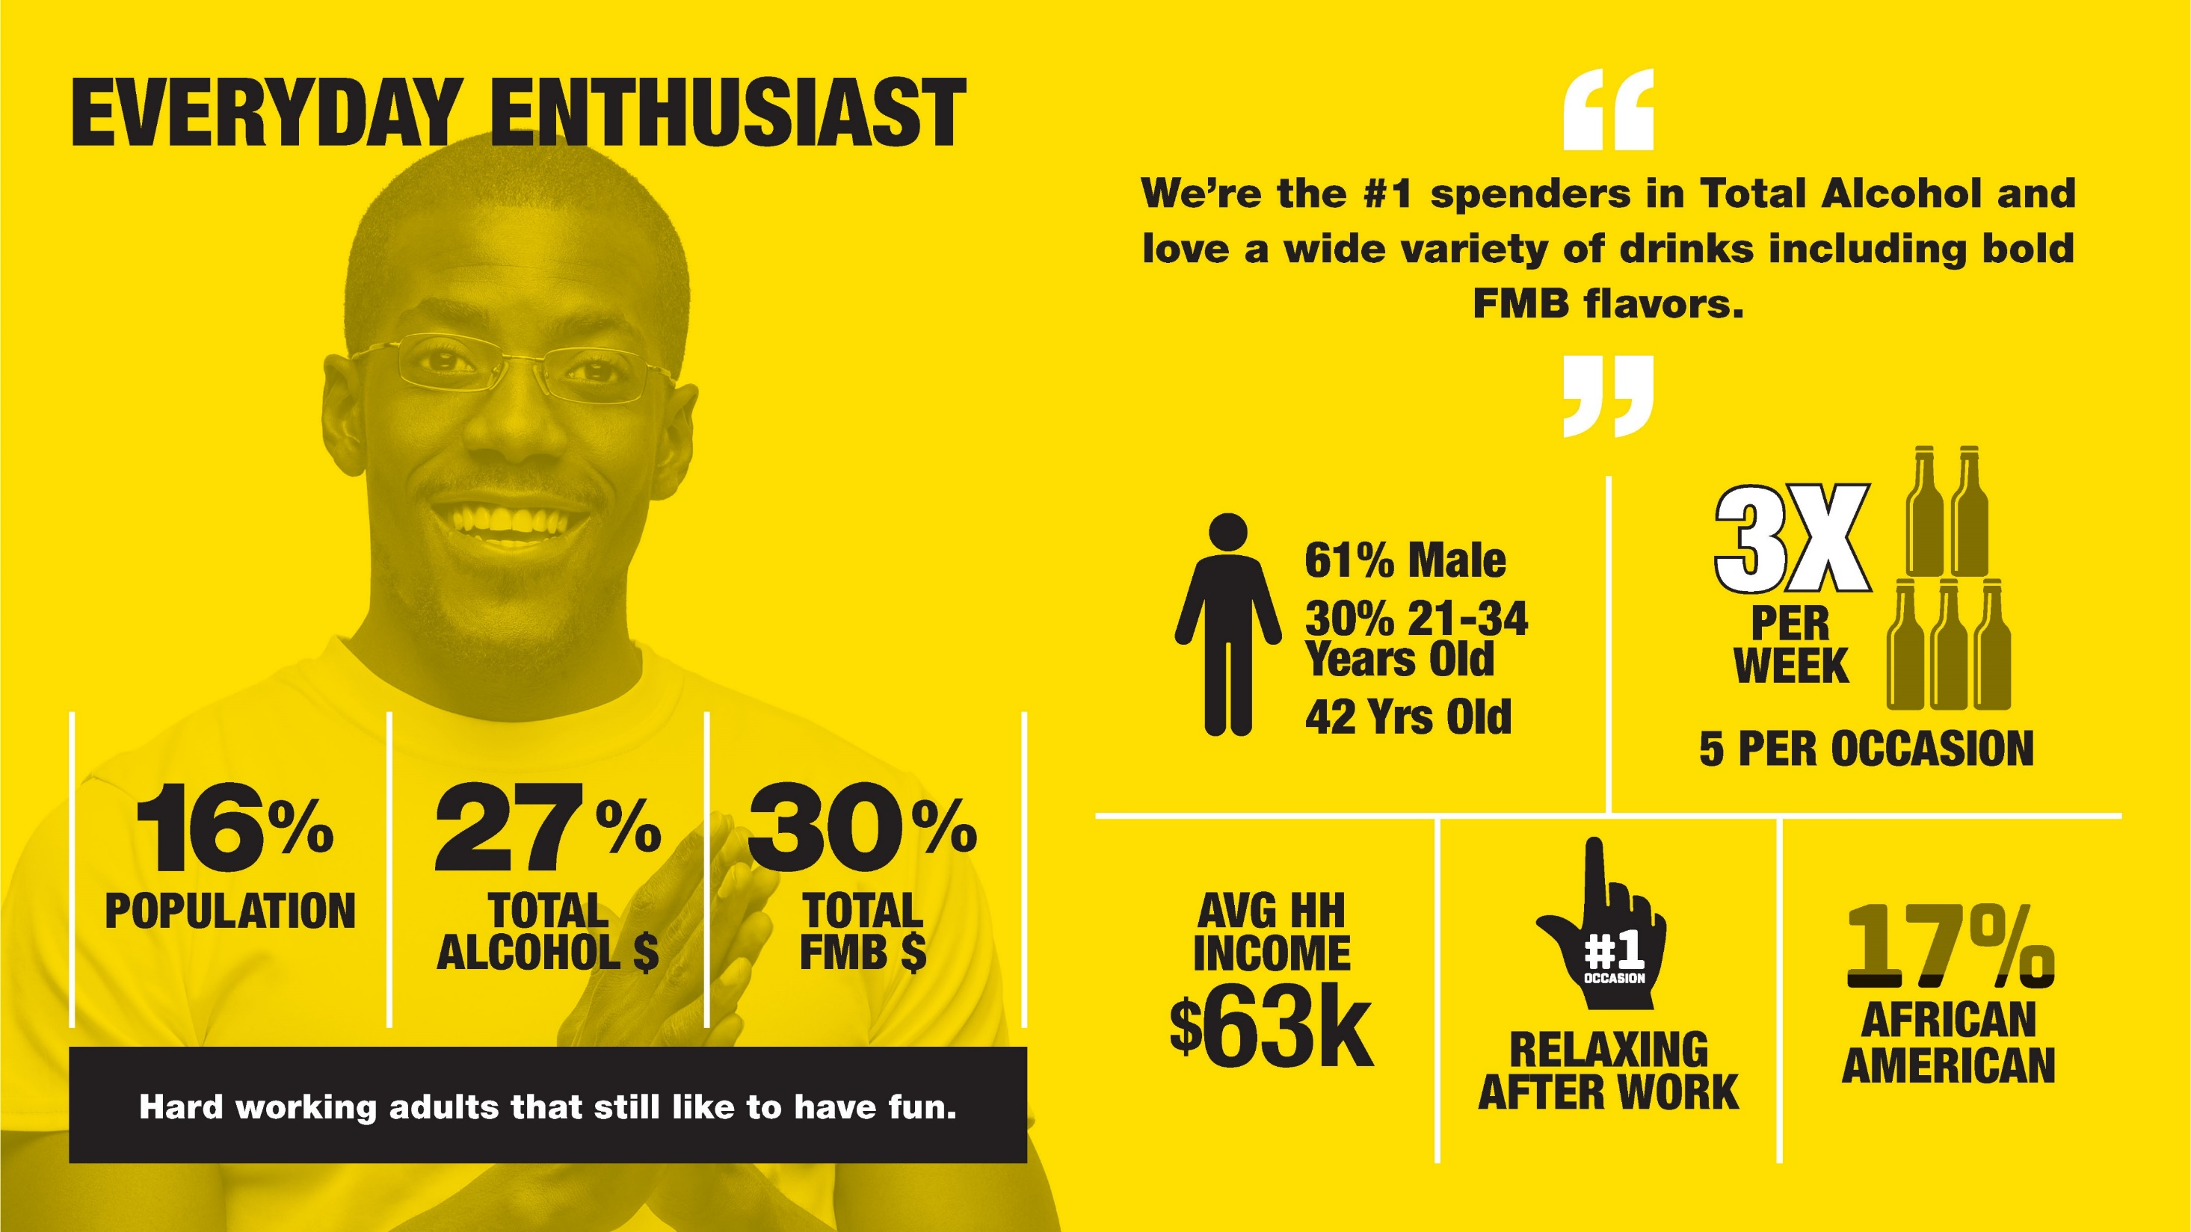
Notes:
Overindex in large format shopping

Slide 29
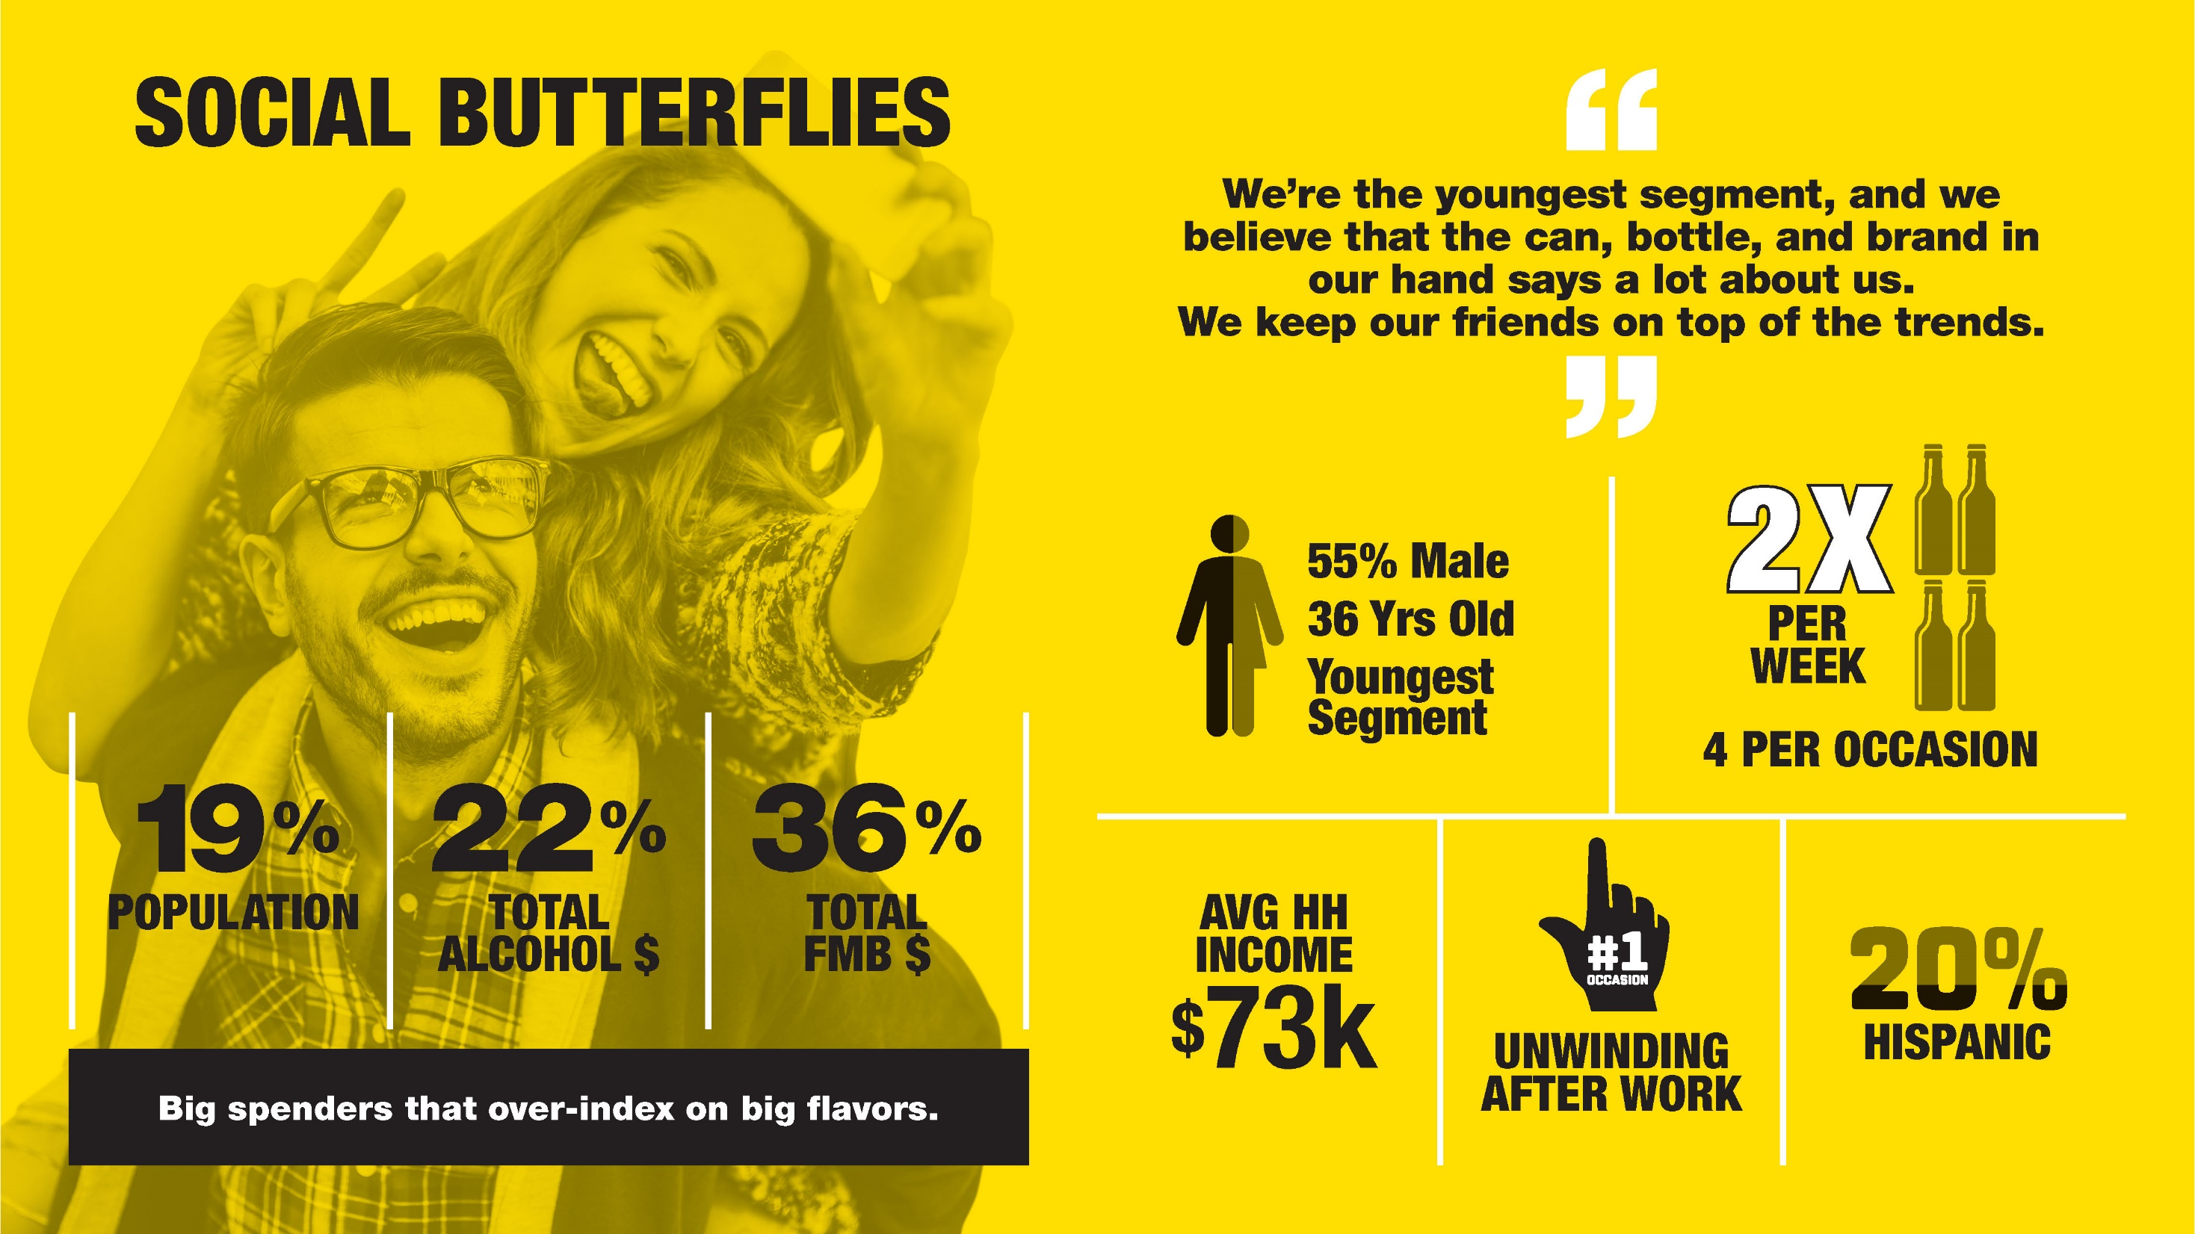
Notes:
Overindex in large format shopping

Slide 30
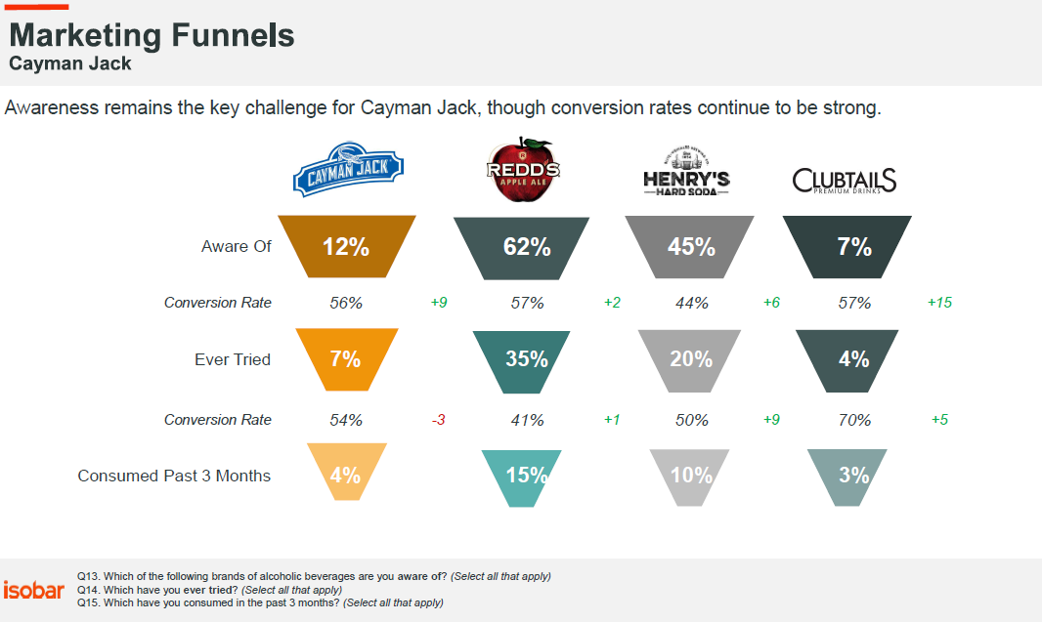

Slide 31
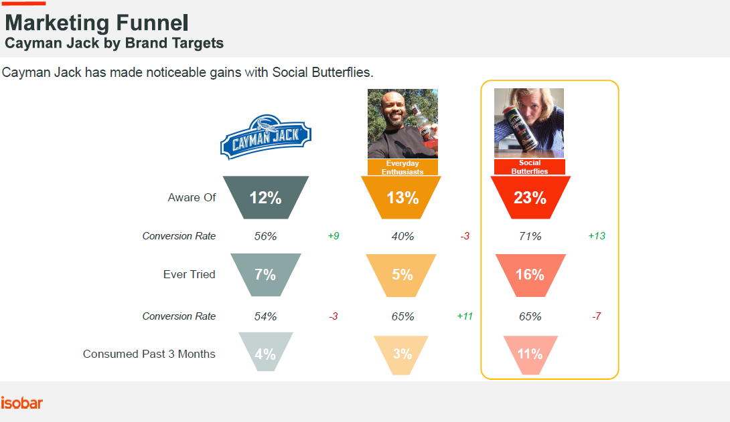

Slide 32
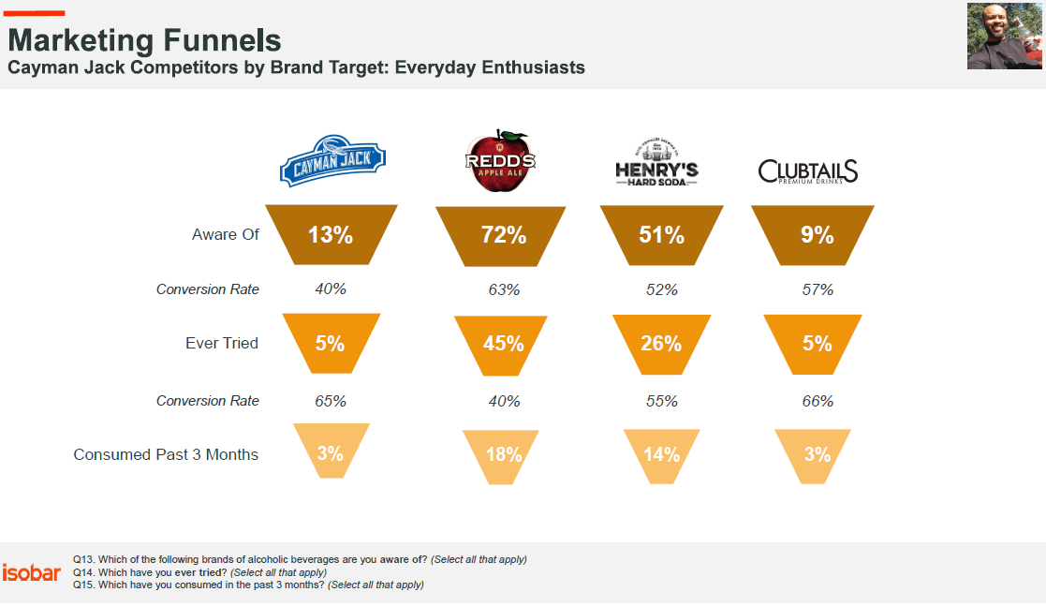

Slide 33
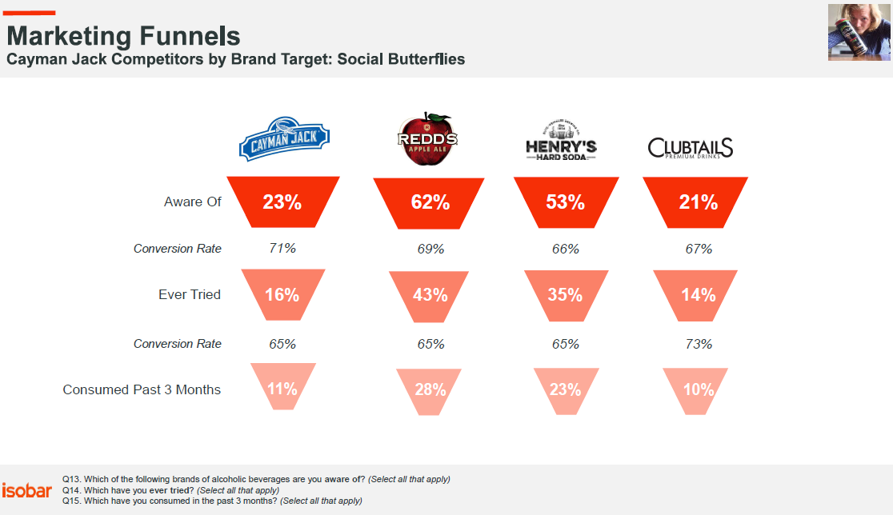

Slide 34
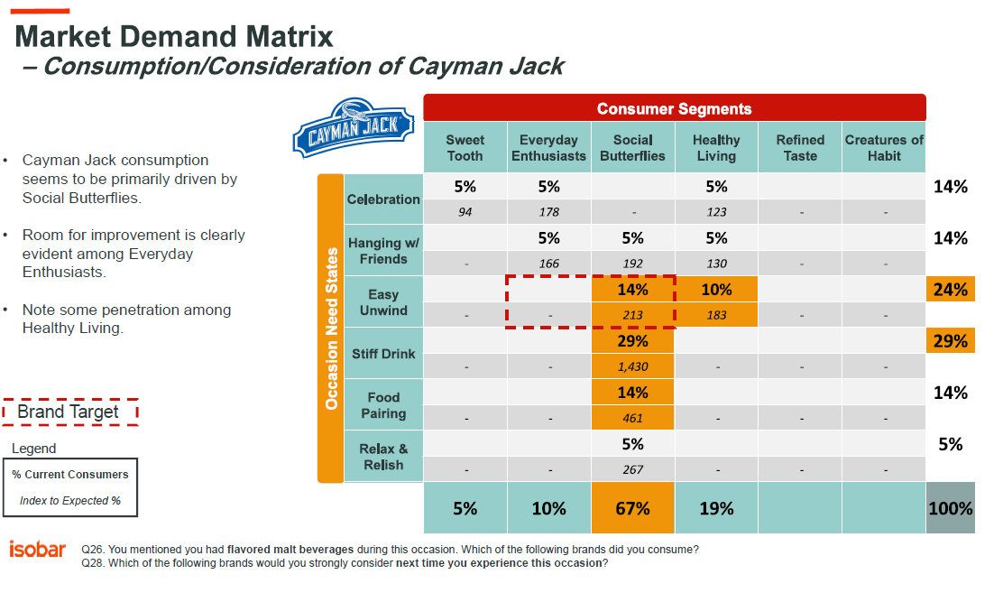

Slide 35
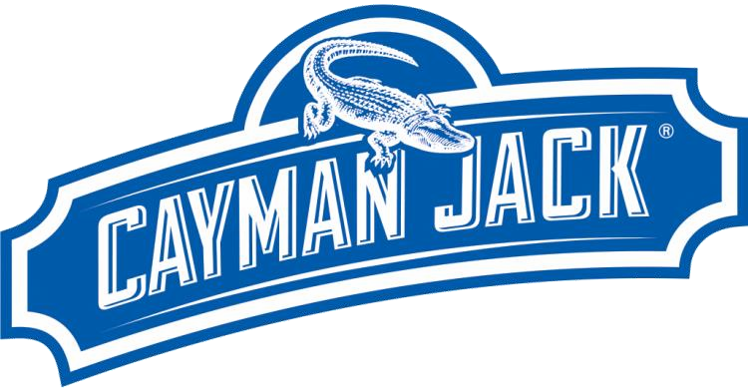
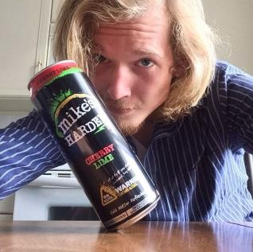


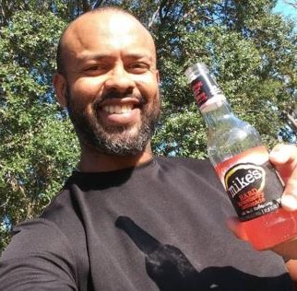
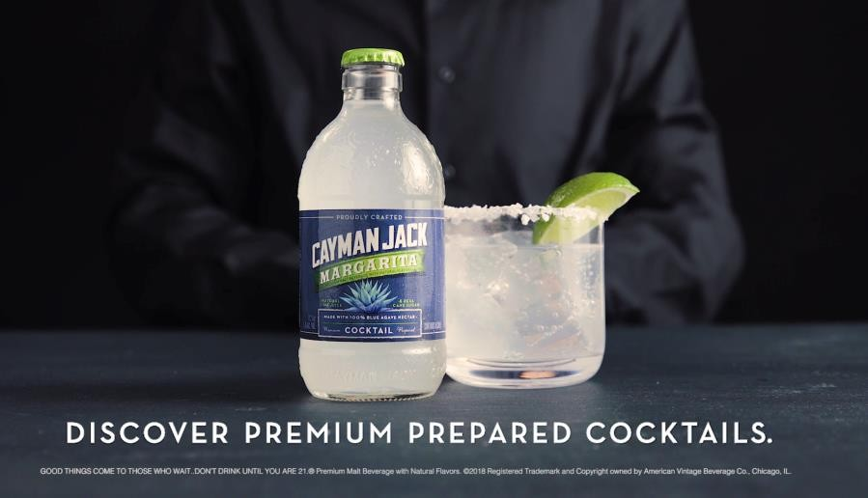
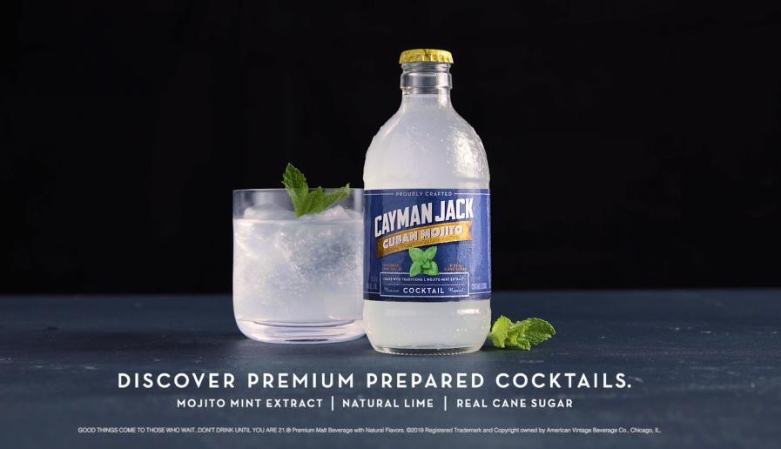

Emotional Connection
(Among Brand Targets)
Cayman Jack has improved on emotional connection with consumers in general, and forges a significantly stronger connection with the brand targets. The “Premier Prepared Cocktail” campaign seems to be driving a stronger sense that these beverages are “better for you” (from natural ingredients) and “more enjoyable” (from premium ingredients).
TOTAL EMOTIONAL ENERGY
MOTIVATIONAL DOMAINS WITH MOST SIGNIFICANT GAINS
Loving
Taken care of
Affectionate
Nurturing
Supportive
Adventurous
Enthusiastic
Involved
In the moment
In the zone
TOTAL ASPIRATION FULFILLMENT ENERGY
TOTAL FRUSTRATION RELIEF ENERGY
3920
3024
3650
3946
SUM TOTAL EMOTIONAL ENERGY
6675 (+48) | 7866

Slide 36


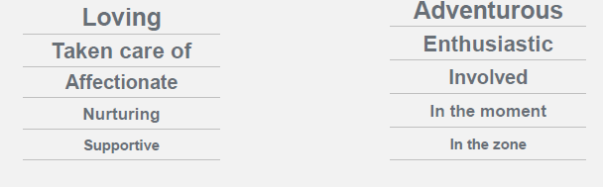
Top Image and Word Associations
NURTURANCE
ENGAGEMENT

Slide 37
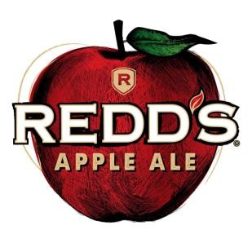
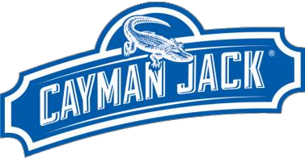


Personality Perceptions
Cayman Jack & Competitors
Fun | 51% | 41% | 61% | 63%
Cool | 50% | 40% | 46% | 51%
Easy going | 44% | 48% | 47% | 65%
Popular | 43% | 41% | 50% | 55%
Social | 40% | 51% | 63% | 70%
Confident | 39% | 33% | 45% | 34%
Proud | 39% | 24% | 28% | 29%
Respectable | 39% | 34% | 38% | 41%
Bold | 38% | 30% | 31% | 16%
Wild and crazy | 36% | 14% | 36% | 22%
Sexy | 36% | 19% | 46% | 37%
Smart | 35% | 21% | 45% | 27%
An 'everyman' | 32% | 26% | 35% | 19%
Active/Energetic | 32% | 30% | 56% | 28%
Edgy | 30% | 18% | 23% | 17%
Old Fashioned / Dated | 27% | 12% | 32% | 20%
Loud | 27% | 15% | 37% | 10%
Healthy | 23% | 18% | 38% | 15%
Funny | 21% | 17% | 39% | 23%
Silly | 21% | 13% | 21% | 21%
A girls' girl | 20% | 18% | 40% | 53%
Quiet | 19% | 18% | 20% | 30%
Juvenile/Immature | 19% | 13% | 34% | 18%
Cayman Jack is most strongly associated with Fun and Cool, though these are shared associations with closest competitors.
Cayman Jack does stand out as a “Proud” brand, but absolute association is not very strong.
Q35. Based on anything you’ve seen or heard, or any impressions you may have, please indicate whether each personality trait or value describes the beverages below.
91
91

Slide 38





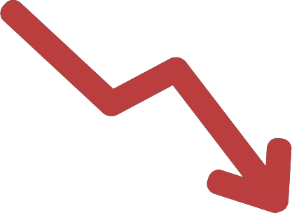
SIGNIFICANT
Cayman Jack Perceptions
Overall perceptions of Cayman Jack has improved significantly.
Overall Impression
GAINS
The absolute best in the market
Excellent, Among the Best
Good
It is just OK
Not good at all
+2
-5
CONTINUED
STRONG SUITS
Popular among my friends
Perfect when I want to be more sophisticated
Lower calorie option
24%
+12
+1
-14
+1
+2
36%
Easy to drink
Refreshing
Crisp, clean taste
Livens up the occasion
Eye catching container / label
Perfect for socializing
-1
SIGNIFICANT
DECLINES
26%
+4
10%
Taste I can enjoy all evening
Doesn’t fill me up
+2
4%
92

Slide 39
Brand Perceptions
Cayman Jack & Competitors
Is popular among my friends | 71 | +9 | 48 | 76 | 59
Has a hand-crafted taste | 71 | +5 | 59 | 69 | 52
Is inexpensive | 68 | +5 | 57 | 76 | 69
Has a lower alcohol content | 67 | +6 | 52 | 69 | 65
Is perfect when I want to feel/be more sophisticated | 67 | +7 | 42 | 70 | 50
Is carbonated | 66 | +7 | 57 | 66 | 59
Is a brand with heritage and tradition | 63 | +6 | 51 | 67 | 66
Is a lower calorie option | 62 | +7 | 42 | 59 | 38
Is a brand that's always introducing new flavors | 59 | +5 | 53 | 74 | 78
Has a wide range of different flavors | 58 | +5 | 56 | 84 | 87
Is a low carb or low sugar beverage | 56 | +5 | 37 | 58 | 37
Is gluten free | 55 | +7 | 38 | 65 | 34
Is perfect for socializing with friends | 74 | -5 | 65 | 79 | 81
Has flavors I like | 73 | -5 | 65 | 77 | 82
Is a treat/reward to yourself | 71 | -5 | 55 | 77 | 68
Does not have a strong alcohol taste | 69 | -5 | 69 | 68 | 76
Has a taste I can enjoy all evening | 67 | -8 | 56 | 78 | 74
Is a good everyday alcoholic beverage | 65 | -6 | 58 | 66 | 73
Doesn't fill me up | 60 | -9 | 57 | 64 | 66
Overall improvement in perceptions may be driven by gains in the following area:
Popularity among friends
Lower calories
Gluten free
Sophisticated
Carbonated
Note some key declines as well:
Less filling
Enjoy all evening
Q34. Please indicate how well each of these characteristics describes the following brand using the 5-point scale below.
93
93

Slide 40
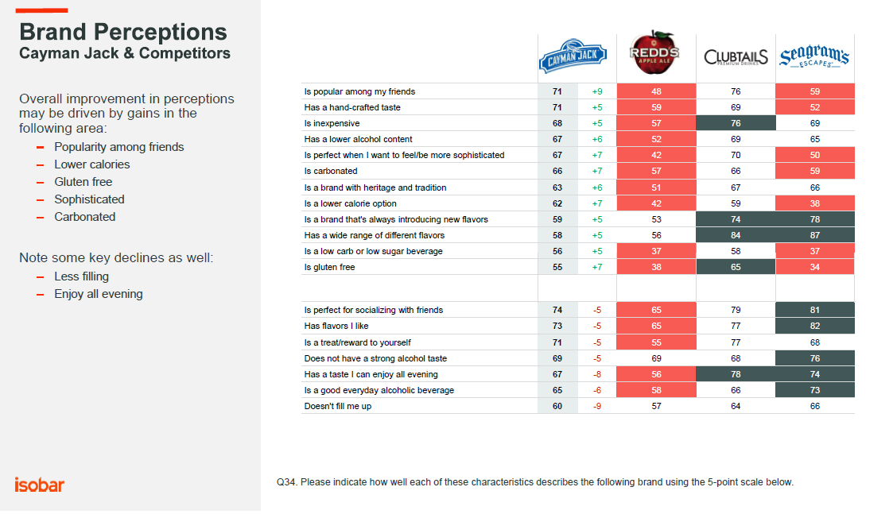

Slide 41
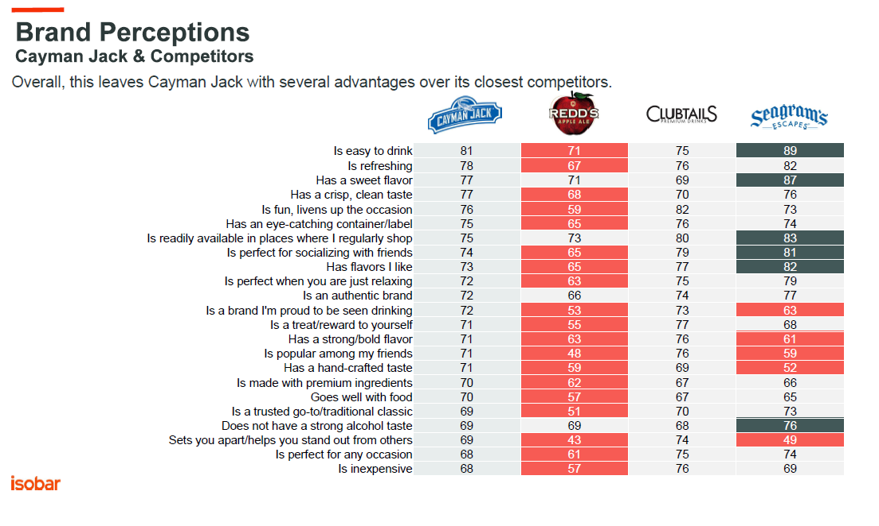

Slide 42
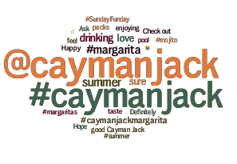

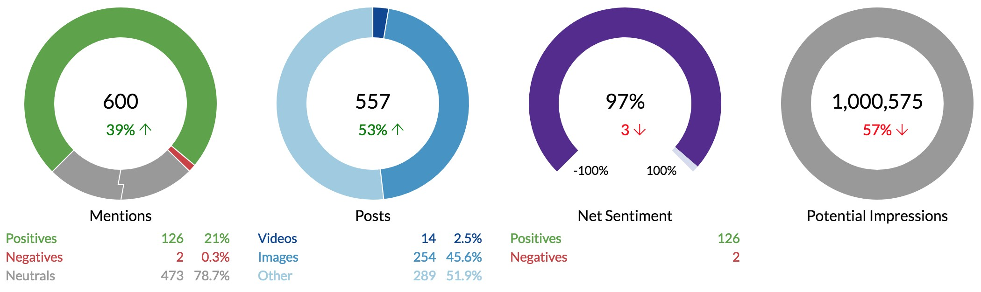
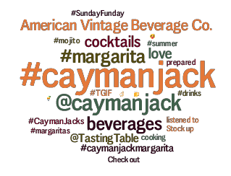
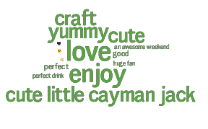
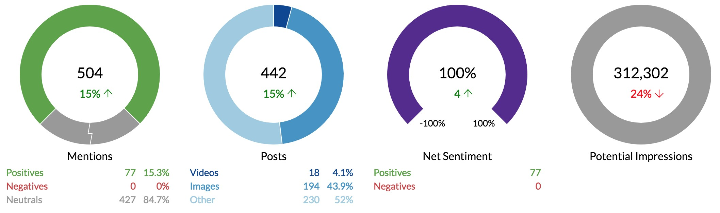
Social “chatter” about Cayman Jack has increased slightly, with “Net Sentiment” holding strong at 97%. Note increase in potential impressions, suggesting that people talking about White Claw have larger networks/followers.
The Cayman Jack Buzz
Social Presence
Mentions
Emotions
Summer 2018
Summer 2017

Slide 43
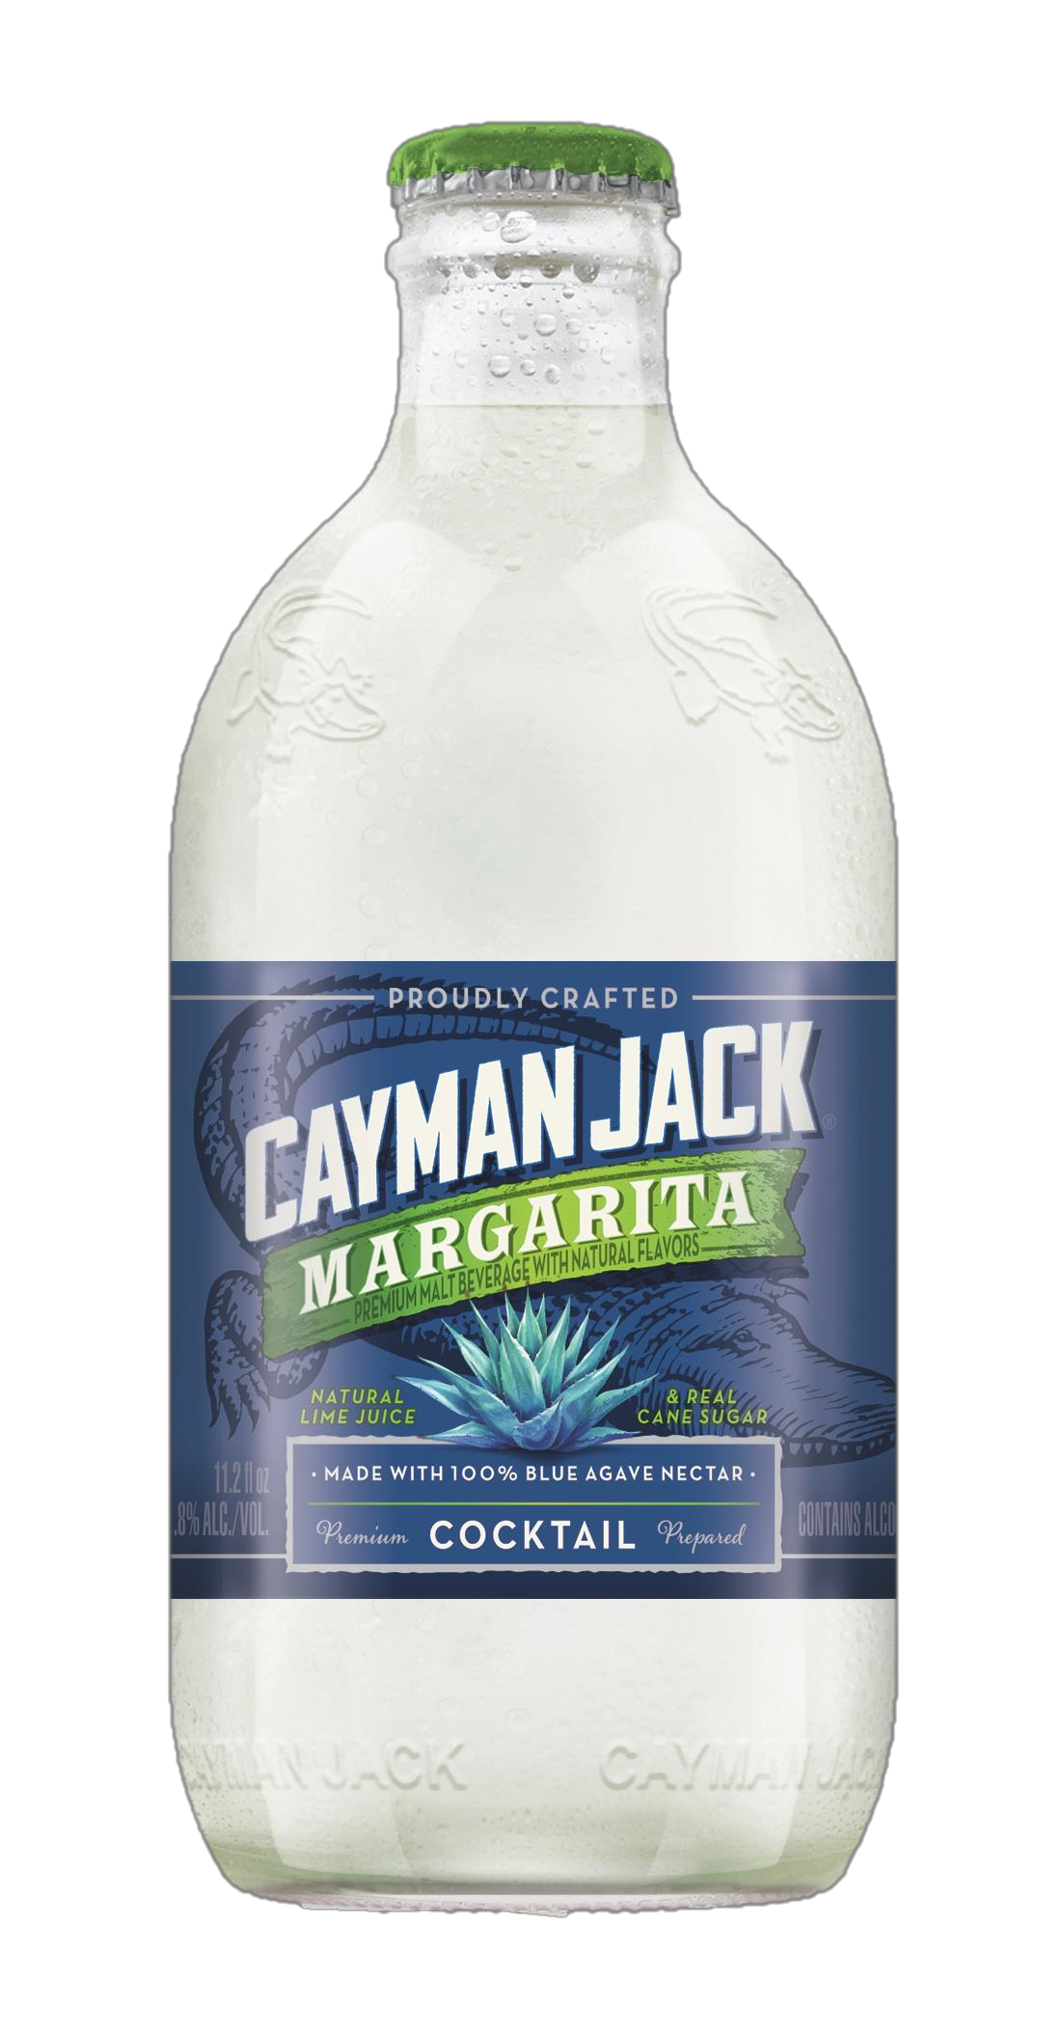
Cayman Jack Bottom Line
The Good News
Cayman Jack continues to have strong awareness-trial- usage conversions
The brand is doing very well with Social Butterflies who are the highest consumers of FMBs
Cayman Jack is also starting to see some penetration among the Healthy Living in Easy Unwind occasions.
Brand perceptions have improved significantly, giving Cayman Jack several competitive advantages.
The “Premier Prepared Cocktail” campaign is working in promoting a “better for you” and “more enjoyable” brand feeling.
Positive social chatter has increased over the last year.
What We Need to Watch For
Awareness remains the key challenge
While perceptions remain strong, Cayman Jack is not well differentiated.
97
97

Slide 44
F21 Brand Planning Update: Cayman Jack 5-Year Brand Vision: Cayman Jack will be the #1 cocktail 6-pack in the segment, leading sales in grocery & c-store
2018 PERFORMANCE OVERVIEW
WHAT’S WORKING / WHAT’S NOT
Working
Focus Markets have shown that our campaigns are working, especially for Mojito
Margarita already resonates with national consumers in both large and small format
Not Working
Mojito outside of focus markets is struggling compared to margarita
With only three SKUs, two of which are Margarita, Cayman Jack is in danger of being seen solely as a margarita brand
 | $$$ | $ Growth | CWD | CWD Growth | Velocity | Velocity Growth
Total MULO+C | $26.4M | +26.1% | 31.22 | +26% | 3.54 | -5.4%
Margarita 6pk | $18.9M | +34.9% | 28.09 | +25.7% | 2.74 | +2.0%
Mojito 6pk | $3.0M | +11.3% | 11.31 | +10.8% | 2.09 | -6.2%
Margarita 12pk | $3.0M | N/A | 10.40 | N/A | 2.09 | N/A
Single Serve | $776K | -42.6% | 6.46 | +5.8% | 4.46 | -2.7%
F21 KEY IMPERATIVES FOR GROWTH
A national launch
National support that strategically mirrors focus markets
Distribution increases
New flavor(s)
Variety pack
F21 KEY PLANNING QUESTIONS
Should Cayman Jack be launched nationally?
What level of support is needed for a national launch?
Does Cayman Jack need a single serve?
Will a variety pack improve Cayman Jack’s performance?
Is a third flavor necessary and what should it be?
IRI, Total MULO + Conv, Food, & Convenience Latest 52 weeks ending 11/04/18

Slide 45
SWOT Analysis
Strengths
Nationally Margarita 6pk is one of the fastest growing FMBs
Margarita 6pks are winning in convenience multi-packs
Mojito 6pk and Margarita 12pks are growing quickly inside of focus markets
Weaknesses
Nationally mojito 6pks are growing slowly
MULO+C distribution is low for a brand with a national footprint
Nationally Cayman Jack is a margarita brand and not a cocktail brand
Opportunities
A national focus on Mojito and a new flavor would solidify Cayman Jack as a cocktail brand
A variety pack
A single
Exploring Fall as a secondary Cayman Jack season
Threats
The Ritas continue to dominate margarita flavors, accounting for more than half of all cocktail-themed FMB sales
C-store continues to be dominated by singles, without one Cayman Jack is losing ground

Slide 46
What’s Working / What’s Not
What’s Working
Focus Markets have shown that our campaigns are working, especially for Mojito
Margarita already resonates with national consumers in both large and small format
The Brand Pyramid
What’s Not
Mojito outside of focus markets is struggling compared to margarita
With only three SKUs, two of which are Margarita, there is a danger that Cayman Jack will be seen as a margarita brand

Slide 47
Cayman Jack – Growth Imperatives
A national launch
National support that strategically mirrors focus markets
Distribution increases
New flavor(s)
Variety pack

Slide 48
2020 Key Questions
3) Does Cayman Jack need a single serve?
4) Will a variety pack improve Cayman Jack’s performance?
5) Is a third flavor necessary and what should it be?
1) Should Cayman Jack be launched nationally?
2) What level of support is needed for a national launch?

Slide 50
Appendix

Slide 51
Cayman & the Category – Fall
Overall
 | Dollars | % Change Year Ago | Price per Unit | % Change Year Ago
Beer | $9,018,703,266 | +1.6% | $6.93 | 0.6%
Craft | $715,174,157 | +16.1% | $4.07 | 4.4%
FMB | $1,082,643,068 | +2.4% | $9.70 | -0.9%
Cider | $112,366,632 | +8.8% | $8.07 | 4.0%
Hard Seltzer | $133,864,390 | +214.7% | $10.72 | -3.5%
Cayman Jack | $6,823,844 | +29.9% | $9.42 | 18.0%
Add New Notes based on Data
IRI, Total MULO + Conv, September-November, 13 weeks

Slide 52
Cayman Jack by Channel – Fall
 | Dollars | Dollar Growth | Price per Unit | Price Growth | CWD | CWD Growth
MULO-C | $6,823,844 | +29.9% | $9.42 | +18% | 28.24 | +25.7%
Food | $3,574,094 | +31.5% | $9.83 | +17.8% | 48.88 | +19.6%
Convenience | $1,609,075 | +22.4% | $8.87 | +36% | 14.94 | +17.7%
Add New Notes based on Data Above
IRI, Total MULO + Conv, Latest 4 weeks ending 12/03/18

Slide 53
Cayman Jack by SKU – Fall MULO+C
 | Dollars | Dollar Growth | Price per Unit | Price Growth | CWD | CWD Growth
MULO+C | $6,823,844 | +29.9% | $9.42 | +18.0% | 28.24 | +25.7%
Margarita 6pk | $4,855,030 | +35.1% | $9.20 | +0.8% | 25.80 | +26.2%
Mojito 6pk | $709,100 | +7.8% | $9.17 | -0.2% | 8.97 | +8.5%
Margarita 12pk | $1,170,867 | N/A | $15.77 | N/A | 9.50 | N/A
Single Serve | $86,533 | -74.5% | $1.93 | -18.2% | 2.74 | -43.3%
Add New Notes based on Data Above
Cayman
IRI, Conv, September – November 2018, 13 Weeks

Slide 54
Cayman Jack by SKU – Fall Food
 | Dollars | Dollar Growth | Price per Unit | Price Growth | CWD | CWD Growth
MULO+C | $3,574,094 | +31.5% | $9.83 | +17.8% | 48.88 | +19.6%
Margarita 6pk | $2,147,982 | +15.9% | $9.23 | +1.2% | 43.11 | +10.2%
Mojito 6pk | $478,263 | +8.9% | $9.30 | -0.3% | 21.84 | +6.8%
Margarita 12pk | $908,853 | N/A | $15.82 | N/A | 26.05 | N/A
Single Serve | $36,932 | -56.8% | $1.69 | -0.8% | 6.58 | -21.3%
Add New Notes based on Data Above
Cayman
IRI, Conv, September – November 2018, 13 Weeks

Slide 55
Cayman Jack – Fall Convenience
 | Dollars | Dollar Growth | Price per Unit | Price Growth | CWD | CWD Growth
Convenience | $1,609,075 | +22.4% | $8.87 | +36% | 14.94 | +17.7%
Margarita 6pk | $1,394,502 | +49.3% | $9.57 | +1.6% | 13.86 | +32%
Mojito 6pk | $50,089 | +14.9% | $9.31 | -5.4% | 1.44 | +11.9%
Margarita 12pk | $114,798 | N/A | $15.56 | N/A | 1.48 | N/A
Single Serve | $49,600 | -80% | $2.15 | -20.7% | 1.35 | -49.1%
Cayman Jack performed well in the fall with Margarita 6pks again leading the way with 50% growth
Six packs can win in convenience
Margarita 12pcks have already overtaken single-serve and Mojito dollars combined
Mojito 6pk growth is less pronounced during the fall
IRI, Conv, September – November 2018, 13 Weeks

Slide 56
Singles vs Pack Performance – Cocktails – 52 Week
 | Dollars | Dollar Year Ago | Volume | Volume Year Ago | Velocity | Velocity Year Ago
MULO-C 1 CT | $187,153,843 | $154,301,078 | 5,263,511 | 4,539,224 | 18.45 | 16.98
MULO-C Multi CT | $124,905,747 | $125,531,146 | 3,692,634 | 3,775,580 | 4.67 | 4.79
Food 1 CT | $17,033,131 | $15,468,361 | 573,875 | 541,671 | 14.61 | 15.34
Food Multi CT | $56,044,498 | $54,698,095 | 1,725,740 | 1,717,235 | 7.66 | 7.79
C-Store 1 CT | $160,543,290 | $131,896,236 | 4,356,313 | 3,722,757 | 18.82 | 16.85
C-Store Multi CT | $43,445,461 | $43,628,441 | 1,229,318 | 1,251,576 | 2.44 | 2.52
Cayman
IRI, Total MULO + Conv, Latest 52 weeks ending 11/04/18 – Without ‘The Ritas’
Notes:
Add to notes:
How much of the volume is from each of the different SKU
How much growth is being driven by each SKU

